Slide 1
自我介紹(niziima Live)

Slide 2
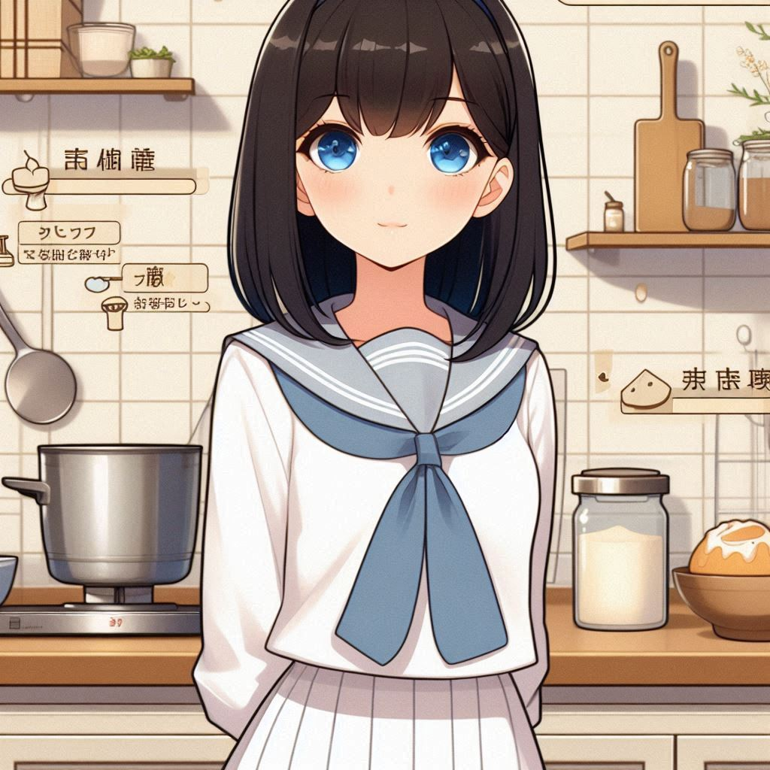
1. 目標
Notes:
日本動漫風格的高中生女學生，黑直髮及肩、藍眼睛，有平瀏海，穿著白色水手服，熱愛烘焙，夢想贏得全國高中生烘焙比賽冠軍，站在廚房背景中，身旁有烘焙用具。
我是個熱愛烘焙的女高中生，夢想是參加全國高中生烘焙比賽，並贏得冠軍，讓我的烘焙技術得到專業的肯定。

Slide 3
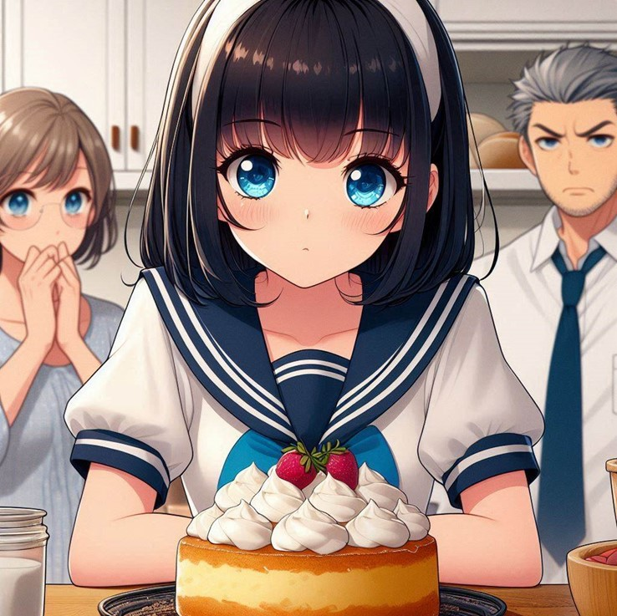
2. 阻礙
Notes:
A blue-eyed high school girl with straight black hair down to her shoulders, flat bangs, and wearing a white sailor uniform. Making desserts in the kitchen, with her parents nearby looking unhappy. The scene is in a Japanese anime style.
但學業壓力很大，家裡也不太支持。

Slide 4
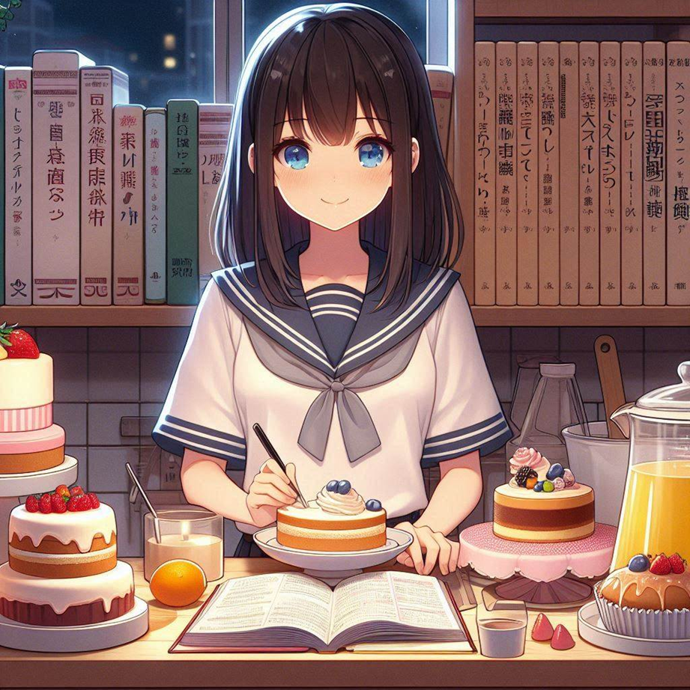
3. 努力
Notes:
Generate a Japanese anime style scene. A girl is in the kitchen making desserts at night, with many reference books behind her. There are a lot of cakes on the side. The girl's appearance is chest-length straight black hair, flat bangs, and blue eyes. A high school girl wearing a white sailor uniform.
儘管如此，我每天課後都會練習做甜點，努力平衡學業和烘焙。

Slide 5
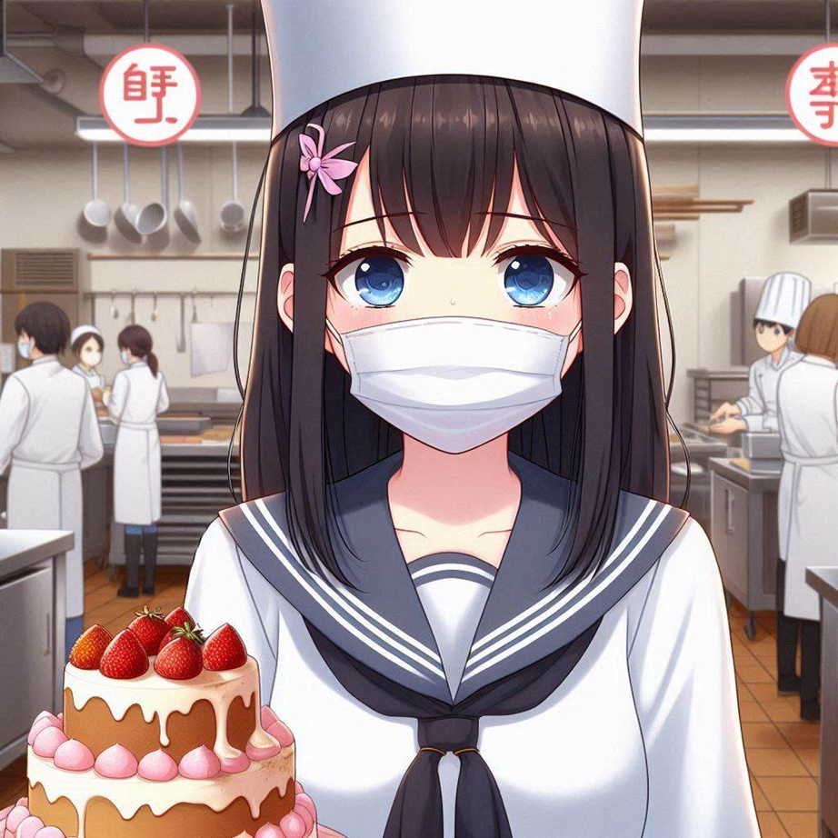
4. 結果
Notes:
Generate a Japanese anime style scene. A girl entered a dessert-making competition, but her cake failed. The girl's appearance is chest-length straight black hair, flat bangs, and blue eyes. A high school girl wearing a white sailor uniform. Wearing a mask and looking sick. In the background is a large kitchen with many chefs.
但參加比賽時因過度疲勞感冒，蛋糕不夠完美，沒有進入決賽，讓我感到非常沮喪。

Slide 6
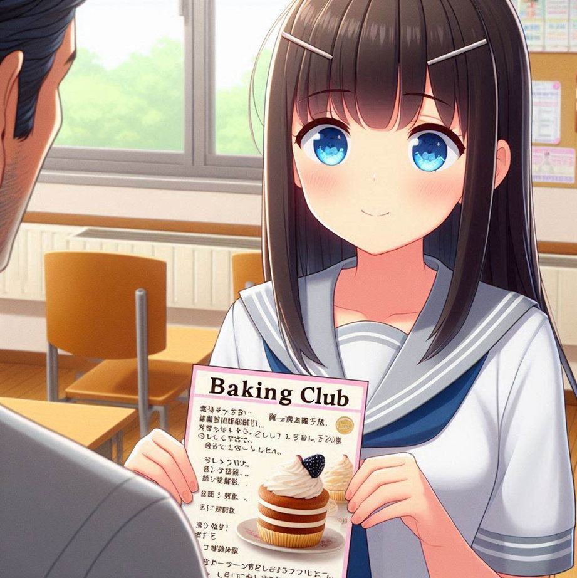
5. 意外
Notes:
Generate a Japanese anime style scene. The scene was in the teacher's office. A teacher was introducing the baking club flyer to the girl. The girl's appearance is chest-length straight black hair, flat bangs, and blue eyes. A high school girl wearing a white sailor uniform.
後來，學校的烘焙老師看到了我的潛力，邀請我加入烘焙社，並推薦我參加本地比賽。

Slide 7
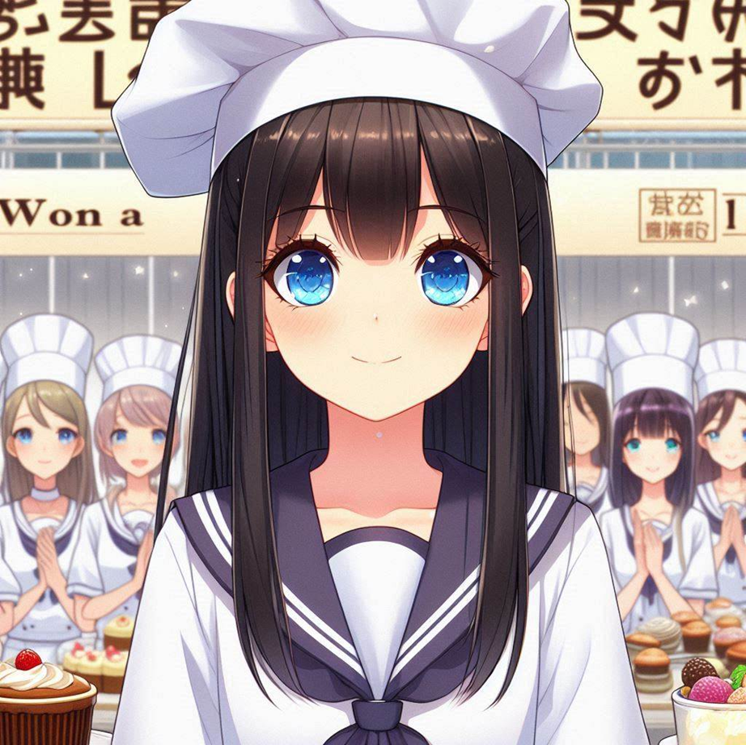
6. 轉彎
Notes:
Generate a Japanese anime style scene. A girl won a baking competition. The girl's appearance is chest-length straight black hair, flat bangs, and blue eyes. A high school girl wearing a white sailor uniform. The scene is a baking competition venue with many chefs.
參加小比賽讓我積累了更多經驗，也獲得了信心。讓我發現自己愛上的是烘焙的過程，而不是結果。

Slide 8
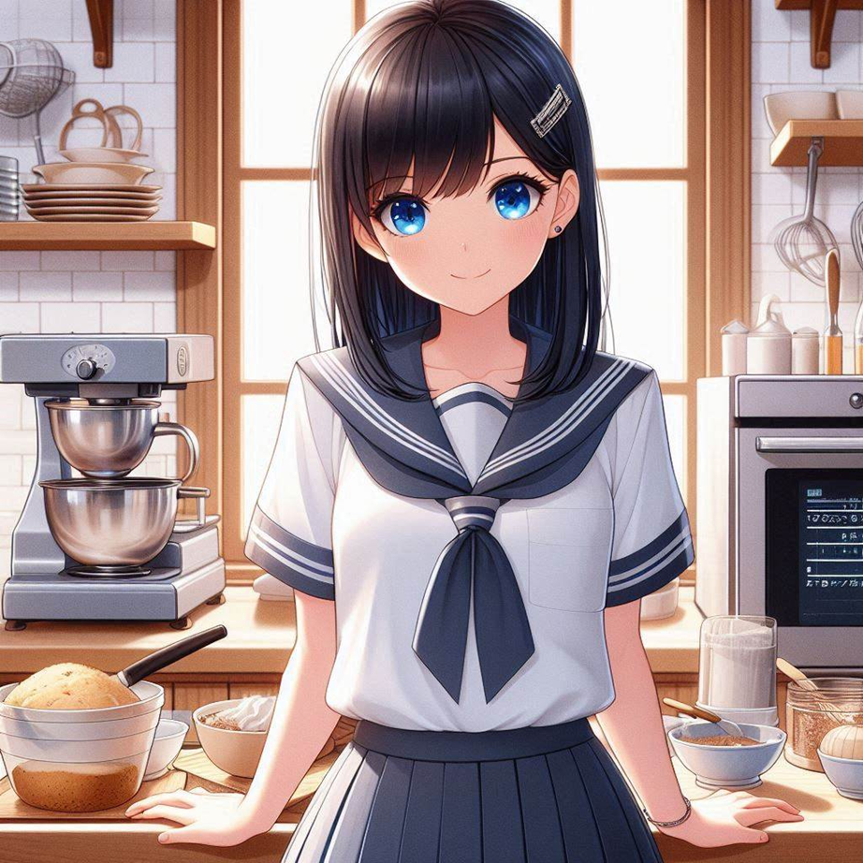
7. 結局
Notes:
日本動漫風格的高中生女學生，黑直髮及肩、藍眼睛，有平瀏海，穿著白色水手服，熱愛烘焙，夢想贏得全國高中生烘焙比賽冠軍，站在廚房背景中，身旁有烘焙用具。
這些小小的成就感讓我決定繼續以烘焙為樂，追求自己熱愛的事物。

